Slide 1
Elastic-BLAST
Tom Madden, PhD
November 16, 2020

Slide 2

Instructor information
Tom Madden, PhD
Team Lead for BLAST (Basic Local Alignment Search Tool) at the NCBI/NLM/NIH

Slide 3
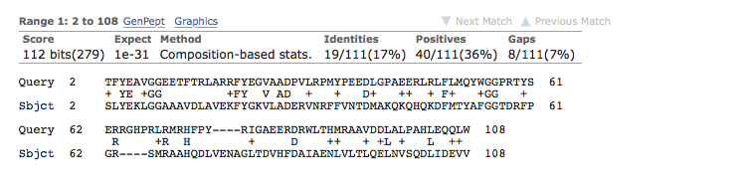
What is BLAST?
Basic Local Alignment Search Tool
Calculates similarity for biological sequences.
It produces local alignments. Only a portion of each sequence must be aligned.
Use statistical theory to determine if a match might have occurred by chance.

Slide 4
What is Elastic-BLAST?
Elastic-BLAST is a command line tool to align large numbers (millions of bases/residues) of nucleotide and protein sequences against BLAST databases.
Elastic-BLAST implements best practices for searching on the cloud so you can concentrate on science.

Slide 5

An Elastic-BLAST application
Annotation of mRNA transcripts with functional and biological processes
BLAST is used to align an assembled transcriptome against annotated databases of proteins or nucleotides.
blastp open reading frames against non-redundant database (nr)
rpsblast open reading frames against Conserved Domain Database (cdd)
blastn transcripts against nucleotide database (nt)
rpstblastn transcripts against CDD database
Example annotation project:
Opuntia streptacantha (nopal) transcriptome (PRJNA320545): 474,563 transcripts (217 million base pairs)

Slide 6




Several components to Elastic-BLAST
Containerized version of BLAST
An orchestration program
BLAST Databases
Your queries
Your BLAST options

Slide 7
BLAST in Docker
Use docker because:
It provides isolation between application and machine it’s on
It works well with orchestration packages like Kubernetes
It’s easy to install an image
Dockerized the BLAST+ command-line executables
Works with databases hosted on cloud providers
Docker is a type of container. Singularity is another.

Slide 8
Kubernetes
Open-source package to orchestrate containers
Used by Elastic-BLAST to start and stop instances, download databases, and schedule work.
Often written as k8s since “ubernete” is 8 letters
Joke about Kubernetes walking into a bar:
k102n (heard on ”Containers on the Couch”)

Slide 9
BLAST Databases at AWS and GCP
Currently 26 databases.
Same databases at the NCBI FTP site and the cloud providers.
Examples
Refseq Eukaryotic Representative Genomes
16S database based on Targeted Loci.
Human and mouse genomes
Full list:
https://github.com/ncbi/blast_plus_docs#blast-databases

Slide 10
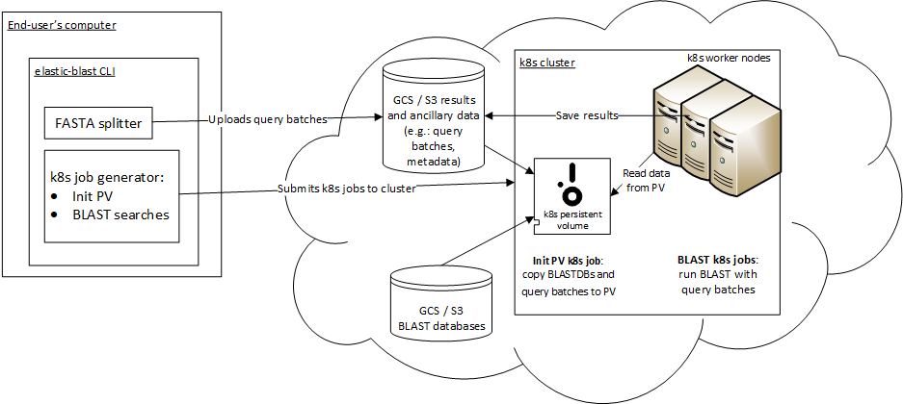
ElasticBLAST architecture
Notes:
Technologies:
K8s
Docker BLAST+
Python CLI app
Cloud: object storage, block storage

Slide 11
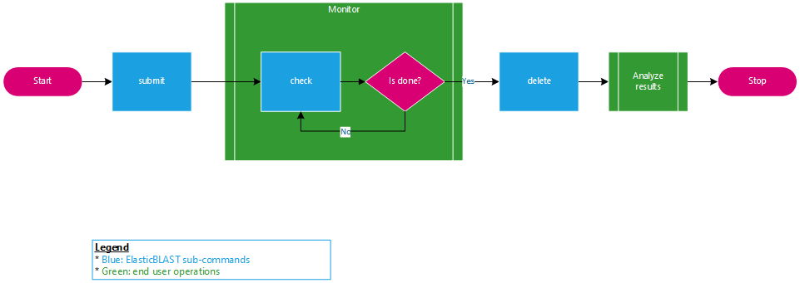
How to use Elastic-BLAST?
Visit the quick start! https://elbdoc.readthedocs.io/

Slide 12
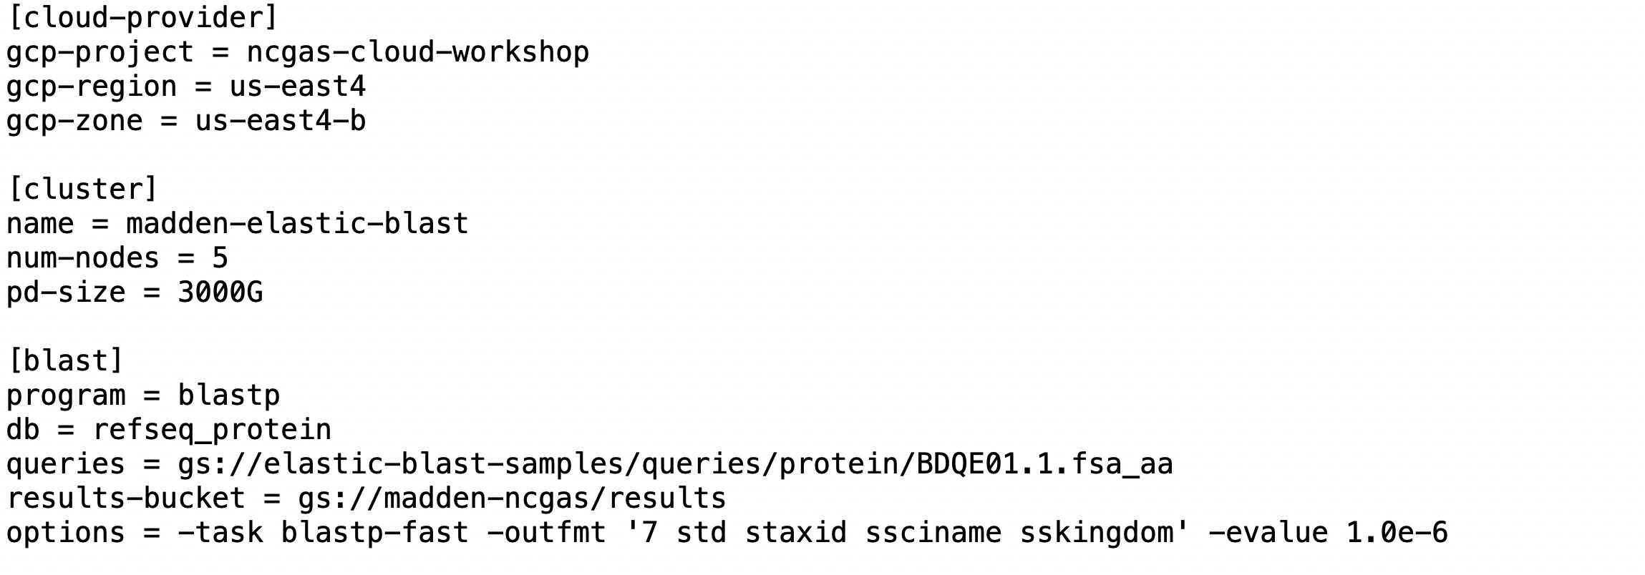
Example config file for Elastic-BLAST
Set once, leave alone
Can be mostly left alone, but change if a different number or size of nodes (machines) are desired
BLAST specific

Slide 13
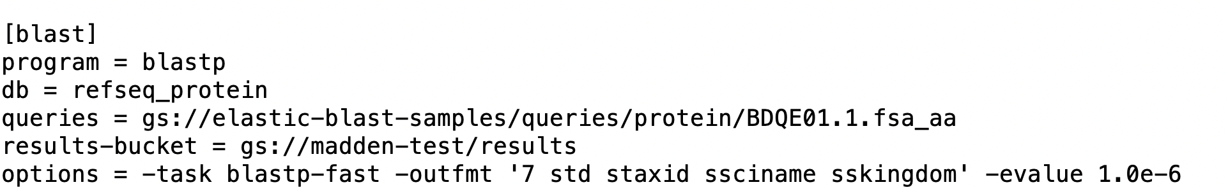
BLAST part of config file
BLASTP (protein-protein) command-line:
Output format
Expect value

Slide 14
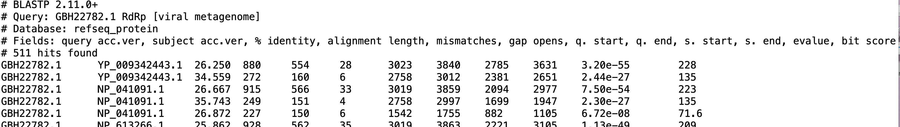
Formatting Options
The –outfmt flag can be used with the argument 6, 7 or 10 to produce tabular or comma delimited output. Additionally, it is possible to specify which fields should be shown. The examples below demonstrate some different reports that can be formatted.
Output for –outfmt 7. Only –outfmt 7 has the header information (lines starting with #). -outfmt “7 std” produces the same report.

Slide 15
Adding Fields to the Standard Set
-outfmt “7 std” specifies the ”standard” fields in the report. Other fields can be added after the standard ones
Output from –outfmt “7 std sskingdom” The standard (“std”) fields are:
‘qaccver saccver pident length mismatch gapopen qstart qend sstart send evalue bitscore'

Slide 16
Comma-delimited Custom Output
Output from -outfmt "10 sacc slen staxids sscinames”. Completely custom output can also be created with -outfmt 6 and 7
See also: https://www.ncbi.nlm.nih.gov/books/NBK279682/

Slide 17
Expect Values
The number of alignments expected by chance with a given score
The larger the database, the more alignments are expected at a given score
“Errors per Query” or “FALSE Positive rate”
For small expect values (less than 0.01), the expect value and p-value are approximately the same.
Also https://www.ncbi.nlm.nih.gov/BLAST/tutorial/Altschul-1.html

Slide 18
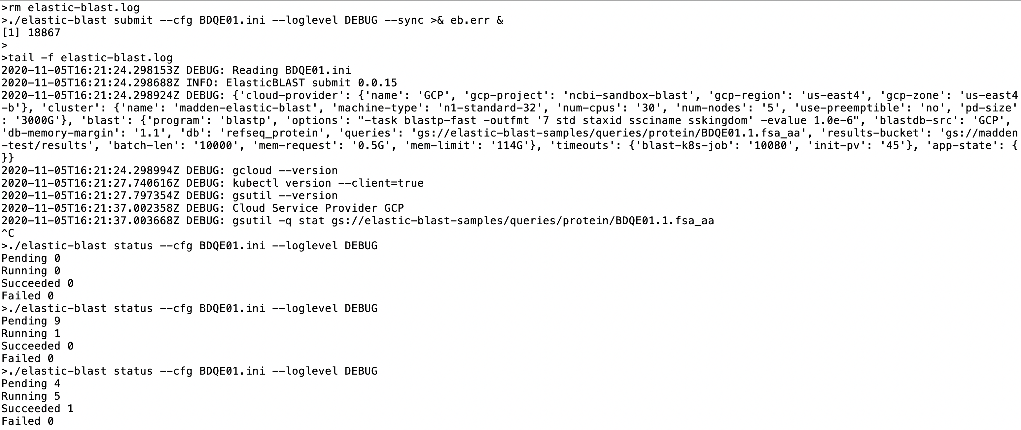
Start a Search

Slide 19
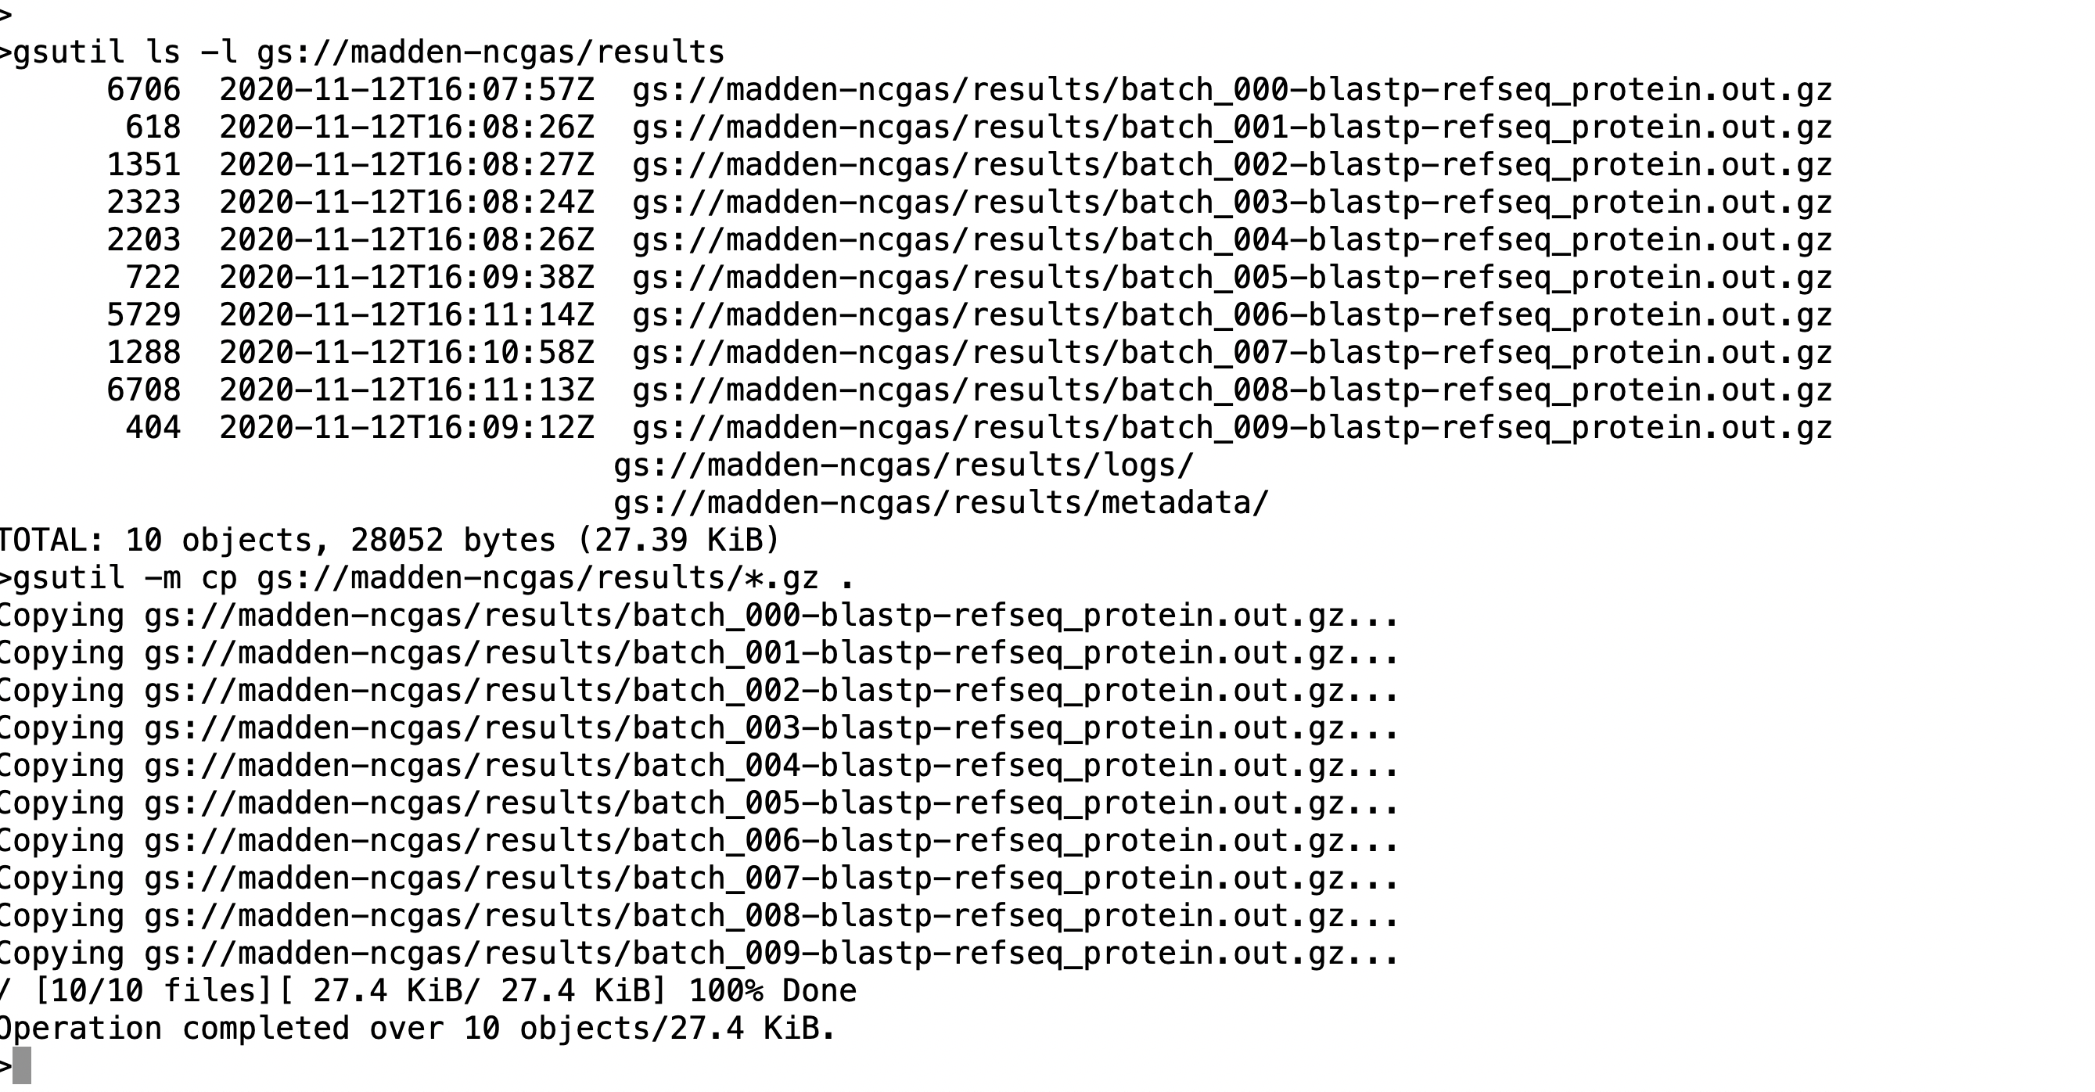
Accessing Results

Slide 20
Using the console to see CPU utilization

Slide 21
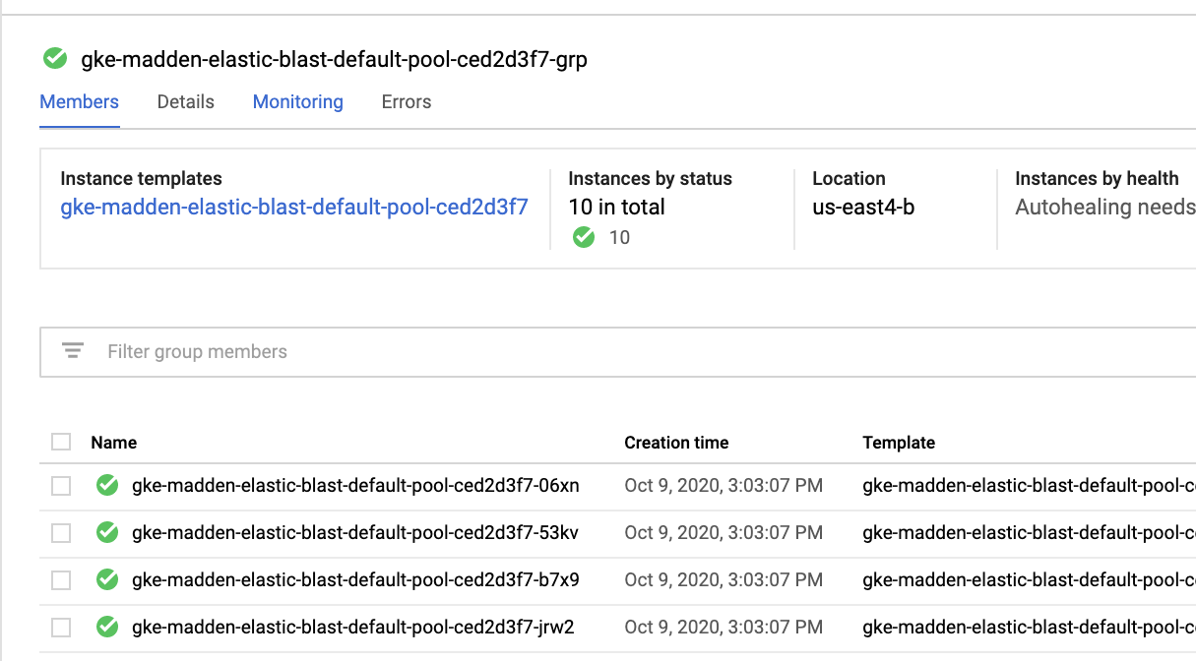
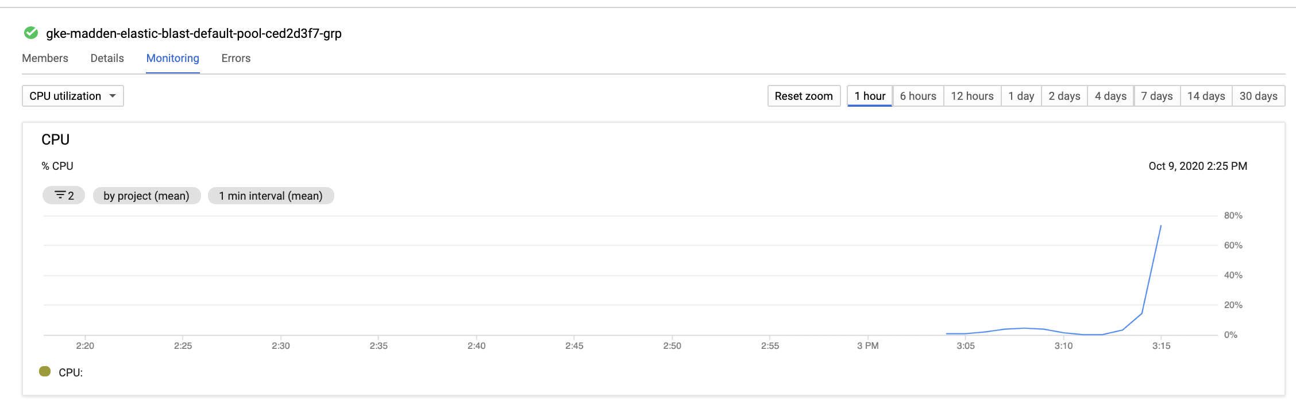
Monitoring

Slide 22
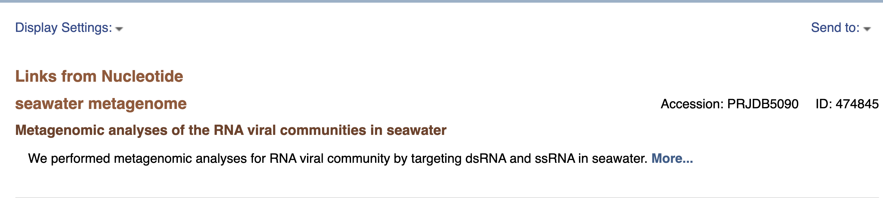
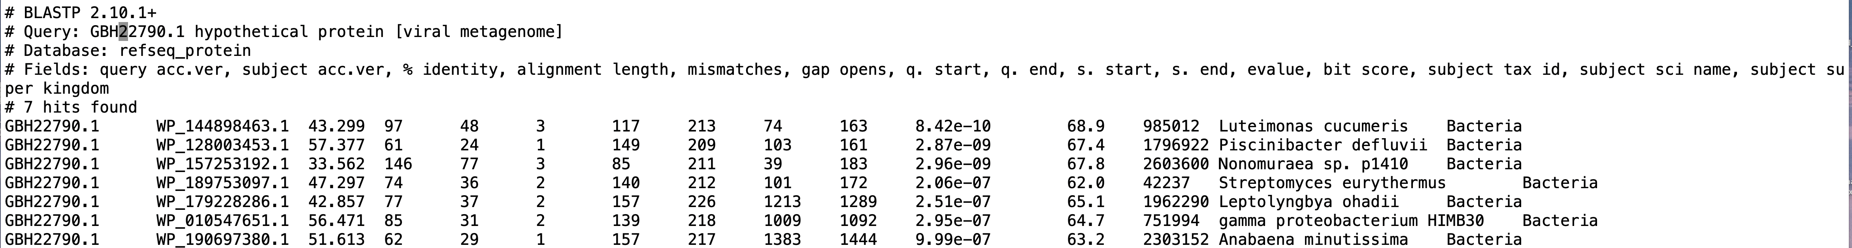
Looking for suspicious matches in our results.
Domain | Number
Virus | 549
Bacteria | 9
Eukaryota | 31

Slide 23
Want to try ElasticBLAST?
NCBI is looking for alpha testers
Interested? Please Contact Dave Arndt at arndtdj@nih.gov

Slide 24
Thank you.
This research was supported by the Intramural Research Program of the NIH, National Library of Medicine.
Christiam Camacho
Yuri Merezhuk
Yan Raytselis
Amelia Fong
Irena Zaretskaya
Dan Soren
Greg Boratyn
Victor Joukov
Anatoliy Kuznetsov
Vadim Zalunin
Roberta Vera Alvarez
Dave Arndt
Scott McGinnis
Peter Cooper
Wayne Matten
Tao Tao
Valerie Schneider
Rodney Brister
Eugene Yaschenko
Kim Pruitt
Steve Sherry

